Slide 1

Attribution Queries
Learn SQL from Scratch
Lee Seng Yong Alvin
31/3/2019

Slide 2
Table of Contents
1. Get familiar with the CoolTShirts.
How many campaigns and sources does CoolTShirts use and how are they related? Be sure to explain the difference between utm_campaign and utm_source.
What pages are on their website?
2. What is the user journey?
How many first touches is each campaign responsible for?
How many last touches is each campaign responsible for?
How many visitors make a purchase?
How many last touches on the purchase page is each campaign responsible for?
What is the typical user journey?
3. Optimize the campaign budget
CoolTShirts can re-invest in 5 campaigns. Which should they pick and why?

Slide 3
1. Get Familiar with CoolTShirts

Slide 4
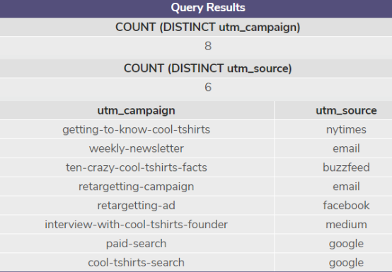
1.1 How many campaigns and sources does CoolTShirts use and how are they related? Be sure to explain the difference between utm_campaign and utm_source.
There are 8 Distinct Campaigns & 6 Distinct Sources. In 6 Distinct Source, there are 8 Distinct Campaign:
“nytimes” has 1 Campaign (getting-to-know-cool-tshirts)
“buzzfeed” has 1 Campaign (ten-crazy-cool-tshirts-facts)
“facebook” has 1 Campaign (retargetting-ad)
“medium” has 1 Campaign (interview-with-cool-tshirts-founder)
“email” have 2 Campaign (weekly-newsletter & retargetting-campaign)
“google” have 2 Campaign (paid-search & cool-tshirts-search)
SELECT COUNT (DISTINCT utm_campaign) from page_visits;
SELECT COUNT (DISTINCT utm_source) from page_visits;
SELECT DISTINCT utm_campaign, utm_source from page_visits;

Slide 5
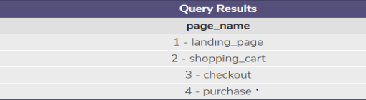
1.2 What pages are on their website?
We want to find all the distinct page names. There are 4 pages in CoolTshirts Website, whereby page name are:
Landing_page
Shopping_cart
Checkout
Purchase
SELECT DISTINCT page_name from page_visits;

Slide 6
2. What is the user journey?

Slide 7
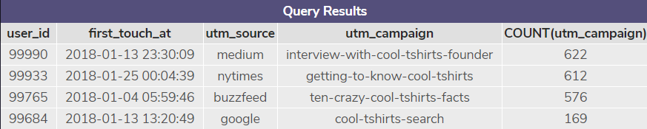
2.1 How many first touches is each campaign responsible for?
The first touches for the 4 campaigns are grouped by campaign from highest to lowest first touches:
Campaign #1 (Interview-with-cool-tshirts-founder): 622 first touch
Campaign #2 (getting-to-know-cool-tshirts): 612 first touch
Campaign #3 (ten-crazy-cool-shirts-facts): 576 first touch
Campaign #4 (cool-tshirts-search): 169 first touch
WITH first_touch AS ( SELECT user_id, MIN(timestamp) as first_touch_at FROM page_visits GROUP BY user_id) SELECT ft.user_id, Ft.first_touch_at, Pv.utm_source, Pv.utm_campaign, COUNT(utm_campaign) FROM first_touch ft JOIN page_visits pv ON ft.user_id = pv.user_id AND ft.first_touch_at = pv.timestamp GROUP BY utm_campaign ORDER BY 5 DESC;

Slide 8
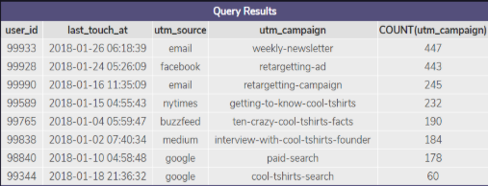
2.2 How many last touches is each campaign responsible for?
The last touches for the 8 campaigns are grouped by campaign from highest to lowest last touches:
Campaign #1 (weekly-newsletter): 447 last touch
Campaign #2 (retargetting-ad): 443 last touch
Campaign #3 (retargetting-campaign): 245 last touch
Campaign #4 (getting-to-know-cool-tshirts): 232 last touch
Campaign #5 (ten-crazy-cool-tshirts-facts): 190 last touch
Campaign #6 (interview-with-cool-tshirts-founder): 184 last touch
Campaign #7 (paid-search): 178 last touch
Campaign #8 (cool-tshirts-search): 60 last touch
WITH last_touch AS (
SELECT user_id,
MAX(timestamp) as last_touch_at
FROM page_visits
GROUP BY user_id)
SELECT lt.user_id,
lt.last_touch_at,
pv.utm_source,
pv.utm_campaign,
COUNT(utm_campaign)
FROM last_touch lt
JOIN page_visits pv
ON lt.user_id = pv.user_id
AND lt.last_touch_at = pv.timestamp
GROUP BY utm_campaign
ORDER BY 5 DESC;

Slide 9
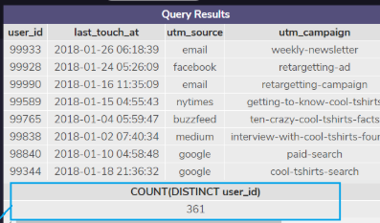
2.3 How many visitors make a purchase?
Count the distinct users who visited the page named 4 - purchase:
361 Distinct Vistors make a purchase
WITH last_touch AS (
SELECT user_id,
MAX(timestamp) as last_touch_at
FROM page_visits
GROUP BY user_id)
SELECT lt.user_id,
lt.last_touch_at,
pv.utm_source,
pv.utm_campaign,
COUNT(utm_campaign)
FROM last_touch lt
JOIN page_visits pv
ON lt.user_id = pv.user_id
AND lt.last_touch_at = pv.timestamp
GROUP BY utm_campaign
ORDER BY 5 DESC;
SELECT COUNT(DISTINCT user_id)
FROM page_visits
WHERE page_name = '4 - purchase';

Slide 10
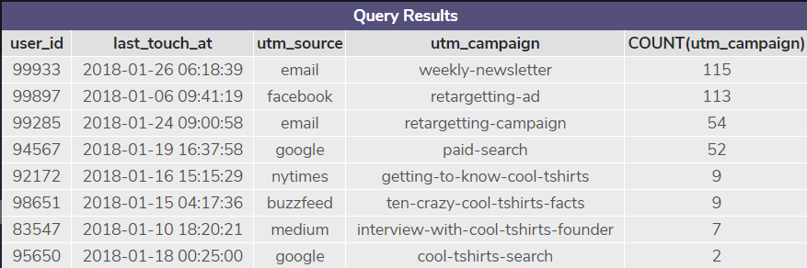
2.4 How many last touches on the purchase page is each campaign responsible for?
The last touches on purchase page (who purchased) for the 8 campaigns are grouped by campaign from highest to lowest last touches:
Campaign #1 (weekly-newsletter): 115 last touch
Campaign #2 (retargetting-ad): 113 last touch
Campaign #3 (retargetting-campaign): 54 last touch
Campaign #4 (paid-search): 52 last touch
Campaign #5 (getting-to-know-cool-tshirts): 9 last touch
Campaign #6 (ten-crazy-cool-tshirts-facts): 9 last touch
Campaign #7 (interview-with-cool-tshirts-founder): 7 last touch
Campaign #8 (cool-tshirts-search): 2 last touch
WITH last_touch AS (
SELECT user_id,
MAX(timestamp) as last_touch_at
FROM page_visits WHERE page_name = '4 - purchase'
GROUP BY user_id)
SELECT lt.user_id,
lt.last_touch_at,
pv.utm_source,
pv.utm_campaign,
COUNT(utm_campaign)
FROM last_touch lt
JOIN page_visits pv
ON lt.user_id = pv.user_id
AND lt.last_touch_at = pv.timestamp
GROUP BY utm_campaign
ORDER BY 5 DESC;

Slide 11
2.5 What is the typical user journey?
The typical user journey comes from these 4 campaigns (weekly-newsletter, retargetting-ad, retargetting-campaign & paid-search); which means campaigns that are repeated over a consistent basis are likely to outperform those campaigns that are not repeated. First touches:
Campaign (Interview-with-cool-tshirts-founder): 622 first touch
Campaign (getting-to-know-cool-tshirts): 612 first touch
Campaign (ten-crazy-cool-shirts-facts): 576 first touch
Campaign (cool-tshirts-search): 169 first touch
Last touches (361visitors made a purchase):
Campaign (weekly-newsletter): 115 last touch = 100%
Campaign (retargetting-ad): 113 last touch = 100%
Campaign (retargetting-campaign): 54 last touch = 100%
Campaign (paid-search): 52 last touch = 100%
Campaign (getting-to-know-cool-tshirts): 9 last touch = 9/612 = 1.5%
Campaign (ten-crazy-cool-tshirts-facts): 9 last touch = 9/576 = 1.6%
Campaign (interview-with-cool-tshirts-founder): 7 last touch = 7/622 = 1.1%
Campaign (cool-tshirts-search): 2 last touch = 2/169 = 1.2%

Slide 12
3. Optimize the campaign budget

Slide 13
3.1 CoolTShirts can re-invest in 5 campaigns. Which should they pick and why?
CoolTShirts should re-invest in 5 campaigns below as these campaigns have are the Top 5 highest last touches & highest rate % of conversion from first to last touch (purchased):
Campaign #1 (weekly-newsletter): 115 last touch [100% Conversion]
Campaign #2 (retargetting-ad): 113 last touch [100% Conversion]
Campaign #3 (retargetting-campaign): 54 last touch [100% Conversion]
Campaign #4 (paid-search): 52 last touch [100% Conversion]
Campaign #5 (ten-crazy-cool-tshirts-facts): 9 last touch [1.6% Conversion]

